Slide 1

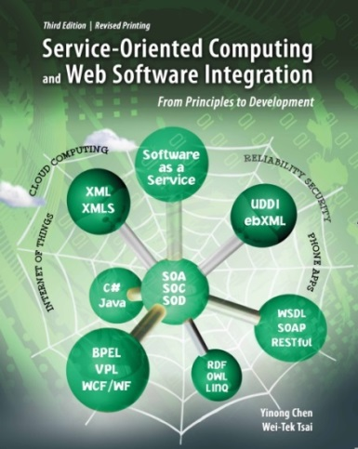
The Final Lecture
Every End is a New Beginning
CSE 445 / 598
Distributed Software Development
Dr. Yinong Chen
https://myasucourses.asu.edu/

Slide 2
Lecture Outline
MVC Web Application Architecture
Course Summary
Outlook of the Next SOC Course and Beyond
  A new software development paradigm consists of many concepts, methods, and technologies.
  We have covered many of them, but they are a fraction of what can be covered in Service-Oriented Computing.
  We try to cover more in the next course

Slide 3
Review: ASP .Net Web Application Architecture
ASP .Net places the presentation layer files (.aspx) and the controller file (.aspx.cs) together.
The advantage is that the related items are placed together.
The disadvantage is we mixed two tiers together (View and Controller)
MyWebApp root
Global.asax
Web.config
.aspx &
aspx.cs
files
.ascx &
ascx.cs
files
.aspx &
aspx.cs
files
.ascx &
ascx.cs
files
.aspx &
aspx.cs
files
.ascx &
ascx.cs
files
User defined dir
App_Data
bin
.aspx &
aspx.cs
files
.dll
file
.aspx &
aspx.cs
files
XML
file
.aspx
files
.aspx &
aspx.cs
files
Web
.config
DB file
.exe
file
.aspx
files
.aspx
files
XML
file
.aspx
files
.aspx
files
XML
file
.aspx
files

Slide 4
MVC as an Architecture Pattern
Hardware Patterns
Software Patters
Patterns
Architecture Patterns (Client-server, tiered, MVC)
Computing Patterns (Computing paradigms)
Design Patterns (Creational, structural, behavioral, and currency patterns)
The MVC pattern was originally formulated in the late 1970s by Trygve Reenskaug at Xerox PARC, as part of the Smalltalk. [http://en.wikipedia.org/wiki/Model%E2%80%93view%E2%80%93controller].
In MVC, the system is divided into three groups of components:
  Model: contains the components representing application logic and data;
  View: Output to the users, including rendering the output data;
  Controller: Input from the user and handlers of the inputs.

Slide 5

Three-Tier Architecture versus MVC
View:
What is sent to
the client browser
Client Browser page
Client Browser page
Presentation
Layer (GUI)
Controller:
Handlers of inputs and output
Application
Processing Layer
  Model:
Conceptual Model of Data
Data
Management Layer
States and Data Sources
Control Flow / Method Call
Event

Slide 6
J2EE’s MVC Architecture
View:
What is sent to
the client browser
Client Machine
Client Browser page
JSP Pages
Controller:
Servlet
Java EE Server
Model:
Enterprise Java Bean (EJB)
States and Data Sources
Enterprise Information System Database Server

Slide 7
MVC in ASP .Net: A four tier Architecture with loosely coupling among the tiers
View: The files that will generate the HTML files for client: the .aspx pages without .cs files
Controller: The aspx.cs files
Other controls and Computing Components and Services
Model: Objects that are performing business logic
States and Data Sources

Slide 8
Model, View, and Controller in ASP .Net
View: A directory contains the components that will generate the application's graphical user interface (GUI) or the presentation layer of the application.
Controller: A directory contains the components that handle user interaction, work with the model, and ultimately select a view to render the displays in GUI.
Model: A directory contains objects that that implement the part of the application logic related to the application's data domain. Often, model objects retrieve and store model state in a date sets, files, and database.

Slide 9
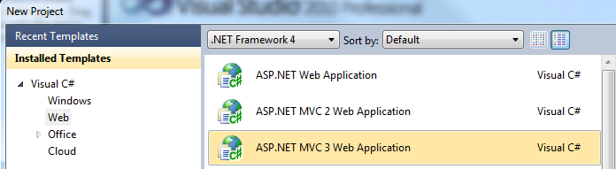
ASP .Net MVC Architecture
Reading: Text Chapter 5, Section 5.7
ASP .Net offers MVC as an alternative project template;
It is available for Windows Forms (desktop) applications, Web applications, and Cloud applications;
Once selected the MVC template, the main components of the application will be organized in three directories: Models, Views, and Controllers.

Slide 10
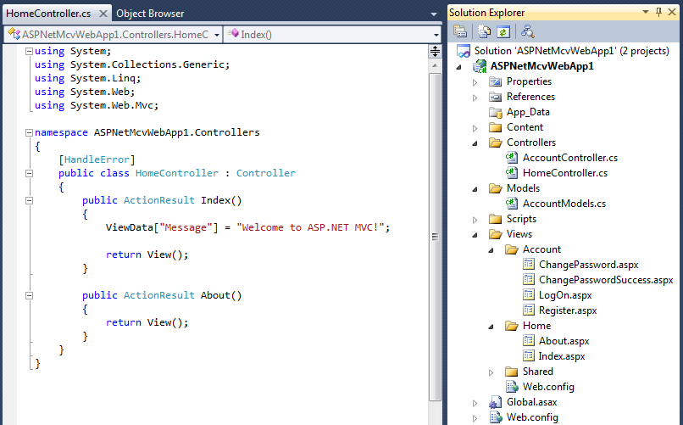
A New MVC Project
.aspx.cs files, are moved to here
Put any business logic not related I/O are here
.aspx files, without .aspx.cs files

Slide 11
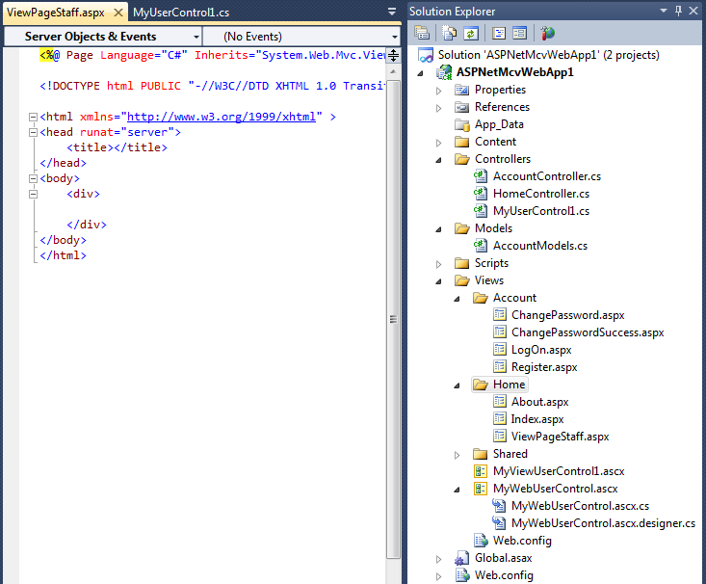
New Items are Added to the MVC Project
MVC user control’s .cs file is added separately here.
A View Page is added here
A MVC user control. Only .ascx file is added
A traditional User control with both .ascx and .cs files

Slide 12
How are View and Controller Connected?
In ASP .Net, the .aspx files and .aspx.cs files are placed together in the same folder. The links are implicit. You must click the buttons to create the implicit links.
In MVC, the links are explicit.
  Each View component contains a list of JavaScript calls
  The Controller of the component contains the methods to be called

Slide 13
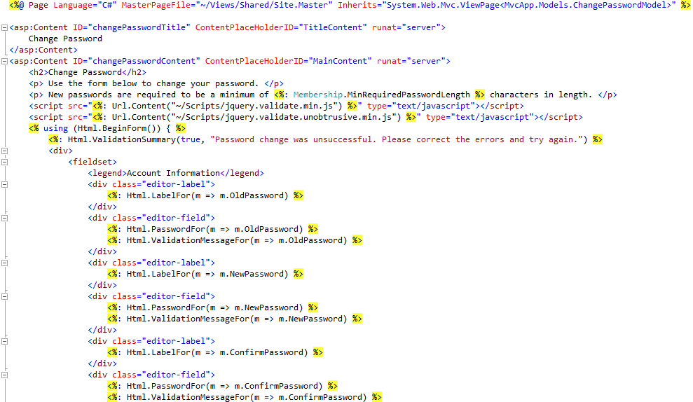
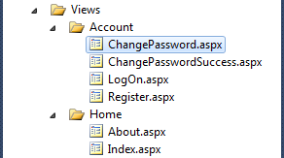
ChangePassword in ChangePassword.aspx, making JS calls

Slide 14

ChangePassword method in AccountController.cs
// POST: /Account/ChangePassword
[Authorize]
[HttpPost]
public ActionResult ChangePassword(ChangePasswordModel model) {
if (ModelState.IsValid) {
// ChangePassword will throw an exception rather than return false in certain failure scenarios.
bool changePasswordSucceeded;
try {
MembershipUser currentUser = Membership.GetUser(User.Identity.Name, true /* userIsOnline */);
changePasswordSucceeded = currentUser.ChangePassword(model.OldPassword, model.NewPassword);
}
catch (Exception){
changePasswordSucceeded = false;
}
if (changePasswordSucceeded) {
return RedirectToAction("ChangePasswordSuccess");
}
else {
ModelState.AddModelError("", "The current password is incorrect or the new password is invalid.");
}
}
// If we got this far, something failed, redisplay form
return View(model);
}

Slide 15

ChangePassword method in AccountModels.cs
public bool ChangePassword(string userName, string oldPassword, string newPassword) {
if (String.IsNullOrEmpty(userName)) throw new ArgumentException("Value cannot be null or empty.", "userName");
if (String.IsNullOrEmpty(oldPassword)) throw new ArgumentException("Value cannot be null or empty.", "oldPassword");
if (String.IsNullOrEmpty(newPassword)) throw new ArgumentException("Value cannot be null or empty.", "newPassword");
// The underlying ChangePassword() will throw an exception rather
// than return false in certain failure scenarios.
try {
MembershipUser currentUser = _provider.GetUser(userName, true /* userIsOnline */);
return currentUser.ChangePassword(oldPassword, newPassword);
}
catch (ArgumentException) {
return false;
}
catch (MembershipPasswordException) {
return false;
}
}

Slide 16
Benefits of MVC Architecture
The loosely coupled feature among the tiers in Views, Models, and Controllers:
Allow team members to develop different parts of the application with reduced interactions;
The template can generate unit tests by automatically adding mock objects (simulated objects) that mimic the behavior of other objects in controlled ways in the application;
The restricted use of the view state, page postback, and related server controls, such as GridView, allows the framework to render the XHTML page less dependent on the server features;
The MVC applications are more friendly with URI-based access used on RESTful services, the feed data formats, and cloud computing environment (CSE446).

Slide 17
Lecture Outline
MVC Architecture
Course Summary
Outlook of the Next SOC Course and Beyond

Slide 18
Summary of the Course: Chapters 1 - 2
Introduction and Overview of the Course (4 lectures)
  Distributed computing
  Distributed software architecture
  Service-oriented computing concepts
  Service-oriented software development
  Research and trend in service-oriented computing (for 598 only)
Multithreading and Distributed Computing (5 lectures)
  Sequential versus parallel computing
  Sharing, synchronization, coordination
  Event-driven software development
  Performance improvement of multithreading using many core processors
  Java-based development and C#-based development

Slide 19
Summary of the Course: Chapters 3 - 4
Essentials in SOC Software Development (4 lectures)
  Service development (in ASP .Net and in WCF)
  Service hosting and service directory
  Basic service client (Web application) development (ASP .Net)
  Java-based service and application development
XML and Related Technologies (4 lectures)
  XML Basics
  XML Document Type Definition (DTD) and XML Schema
  XML processing: different readers and writer
  XML Style and Transformation

Slide 20
Summary of the Course: Chapters 5 - 7
Web Application and Data Management (4 lectures)
  Web computing models: client side and server side
  Web application architecture (ASP .Net)
  Web application components: Web controls and user controls
  Web application components: Global, DLL, and Cookies
  Web data management: Session state, application state, XML file
Security and Reliability (4 lectures)
  Security and reliability concepts
  Forms security
  IIS security, Windows security, and SSL
  Encryption and decryption service and WS-ReliableMessaging
  7. Presentation and View (3 lectures)
  Dynamic graphics generation
  Phone apps with Silverlight and animation
  MVC

Slide 21
Outlook of the Next Course
CSE446/598
Software Integration and Engineering

Slide 22
Thirty years ago,
object-oriented computing emerges
Ten year later,
Everything becomes objet-oriented,
from industry applications to academic classes
Twelve years ago,
service-oriented computing emerges
Six years later,
We have one SOC course at ASU: CSE445
Ten year later, we have two SOC courses at ASU: CSE445 and CSE446
We have more ahead of us in this new paradigm
What Next?

Slide 23
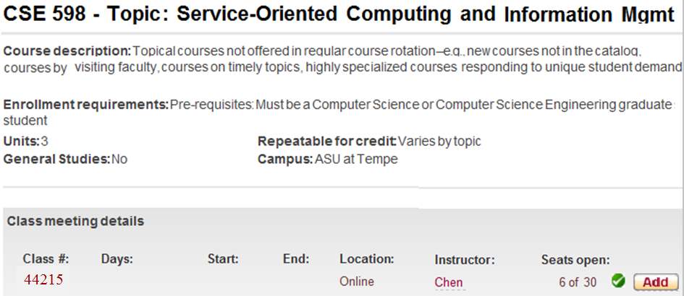
SOC-II for Graduate Students
The new course was initially developed and offered in Summer 2010 and
Summer 2011!

Slide 24
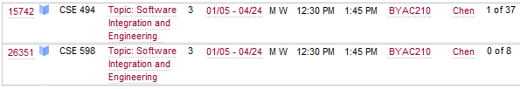
The Graduate Course is Extended to Undergraduate
Software Engineering Concentration Course Map
(CSE 446)
CSE464/598 Software Quality Assurance and Testing
CSE460
Software Analysis and Design
First offer:
Fall 2011 and now every fall
CSE360
Introduction to Software Engineering
[7th semester]
[7th or 8th semester]
CSE446/598 Software Integration and Engineering
[6th semester]
CSE445
Distributed Software Development
First offer:
Spring 2012
and now every spring
[7th semester]
[7th or 8th semester]

Slide 25
From CSE445 (SOC-I) to CSE446 (SOC-II)
CSE445/598
  Language-based SOC software development;
  Must have strong CS background and object-oriented programming skill;
  Largely bottom-up approach
CSE446/598: Emphasis on software integration
  Less emphasis on language-based development
  Workflow composition at component level
  Resource-oriented (REST) and data-driven approaches
  Data services: Databases and interfacing
  Cloud computing

Slide 26

One Text for Two Courses
Part I Distributed Service-Oriented Software Development and
Web Data Management
Chapter 1 Introduction to Distributed Service-Oriented Computing
Chapter 2 Distributed Computing with Multithreading
Chapter 3 Essentials in Service-Oriented Software Development
Chapter 4 XML Data Representation and Processing
Chapter 5 Web Application and Data Management
Chapter 6 Dependability of Service-Oriented Software
Part II Advanced Service-Oriented Computing and System Integration
Chapter 7 Service-Oriented and REST Architecture
Chapter 8 Service-Oriented Software Development and Integration
Chapter 9 Service-Oriented & Event-Driven Computing in Robotics Applications
Chapter 10 Interfacing Service-Oriented Software with Databases
Chapter 11 Ontology and Semantic Web
Chapter 12 Service-Oriented Application Architecture
Chapter 13 A Mini Walkthrough of Service-Oriented Software Development
Chapter 14 Cloud Computing and Software as a Service (SaaS)
CSE445
CSE446

Slide 27
Programming .Net Remoting and REST in WCF
SOC Software Development Environment | Platform- independent Web service | WS-Security WS-Reliability | Distributed transactions | Platform- dependent service | RESTful service
ASP .Net | X
.Net Remoting |  |  |  | X
Enterprise Services |  |  | X
WSE |  | X | X
WCF | X | X | X | X | X

Slide 28
Creating a Platform-Dependent (.Net Remoting) Service
.Net client access the services in C# interface
Self-Hosting
Define an interface
with method signatures
Define a class as a service with methods
Define a .Net application class to host the service
in console application template

Slide 29
RSS as XML in RESTful Services

Slide 30
Atom as XML in RESTful Services

Slide 31
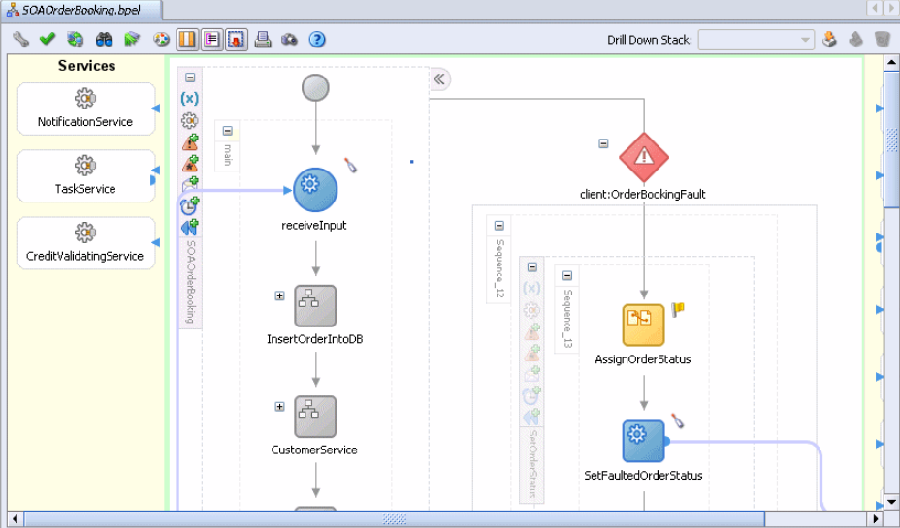
Develop Enterprise Applications in BPEL

Slide 32
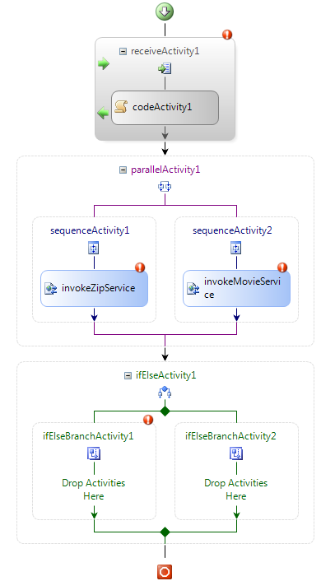
Using Workflow Foundation to Develop Application
http://www.ignyte.com/webservices/ignyte.whatsshowing.webservice/moviefunctions.asmx?WSDL
Enter WS URL:
Enter WS URL:
http://www.webservicex.net/uszip.asmx?wsdl

Slide 33
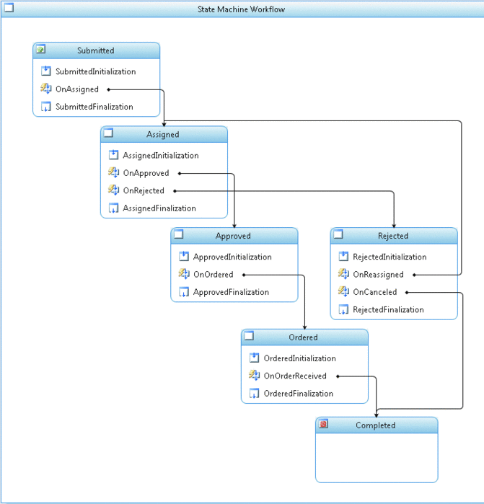
Workflow Foundation Implementing flowchart
User submits request
Submitted
Assigned
approve
Approved
Rejected
reassign
cancel
Ordered
Completed

Slide 34
Message-Based Integration and ESB
http://venus.eas.asu.edu/WSRepository/Services/Messenger/Service.svc
Message Board: One-to-Many with subscription
Message Queue: One-to-One with off-line delivery
Messaging services
publish
subscribe
Client
Web
Client
Client
Board for
topics
Client
deliver
send
Client
Phone
Client
Message Queue
deliver
Create board
Create queue
Administrator

Slide 35
LINQ
OO languages
C#
VB
C++
X
. . .
LINQ addition
Standard constructs
Standard constructs
Standard constructs
Standard constructs
Uniformed data objects
In-memory objects
Different data entities
ADO .Net
data entities
Relational database records
XML nodes

Slide 36
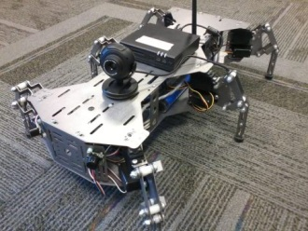
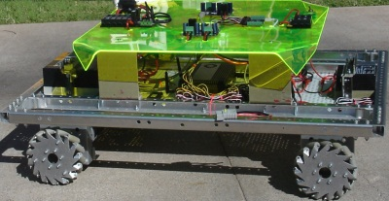
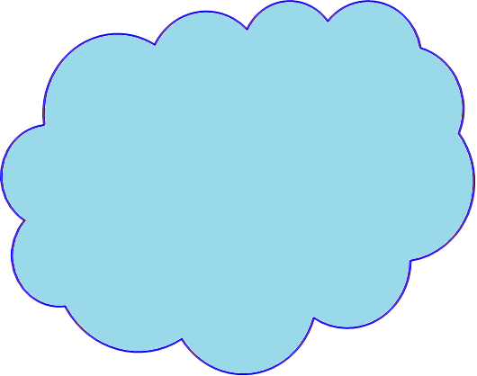
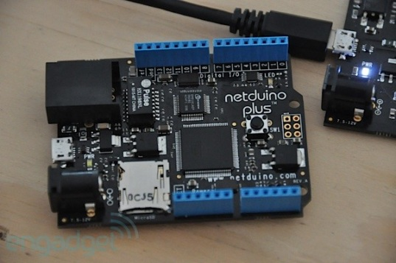
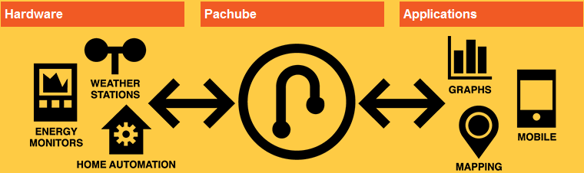
Internet of Things and Robot as a Service
Software as a Service
Platform as a Service
Infrastructure as a Service
X as a Service
Robot as a Service
Cyber Physical Devices
Device as a Service
Cloud Computing Environment
Service Interface in HTTP, URI, REST. WSDL, SOAP, etc.
User data
Server
User hardware
API
Client application

Slide 37
Semantic Web Language Stack
Semantic Web Human User interface
Semantic Web Programmer’s interface
Reasoning/Proof
Data Access
Ontology Instance
Ontology Vocabulary
Ontology Languages: RDF, RDFS, OWL
XML and XML Schema
URI
Unicode
Semantic Web Development Environment

Slide 38
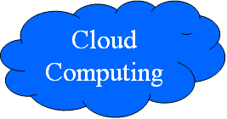
Web 2.0, Web 3.0, and Cloud Computing
Intelligent Web with Web 2.0 + Web 3.0 composition
Web 2.0
mashup
SOC-based Web 2.0
UDDI, WSDL, SOAP
Dynamic
Web 3.0
mashup
WWW
URI, HTML, HTTP
Semantics-based
Web 3.0
RDF, RDFS, OWL
Static
Syntax
Semantics

Slide 39
Cloud Environments to be Discussed
Google App Engine: Free account with limited resources; Java and Python based; Supported by Google APIs and services;
Microsoft Windows Azure: C# and .Net based; Supported by Microsoft CRM (Customer Relationship Management), ERP (Enterprise Resource Planning ), and Web services;
Oracle Exalogic Elastic Cloud in a Box: From hardware to software in a box. Designed to provide the an environment for enterprise Java applications and Java-based infrastructure; It scales horizontally with no degradation of system performance as the size of the cloud increases.
Saleforce.com: Large number of services in CRM and ERP;
Amazon Elastic Compute Cloud: Large number of services in e-commerce, supported by development platform and infrastructure.

